Slide 1
REAL-TIME NOISE CANCELLATION AND NOISE SUPPRESSION FOR ENHANCED SPEECH CLARITY USING SPEECH SEPARATION MODELS

Slide 2


This is our team.
Balacheran V.
Sankar Kiran M.
Department of Artificial Intelligence & Data Science Sethu Institute of Technology
Department of Artificial Intelligence & Data Science Sethu Institute of Technology

Slide 3
We will talk about this first.
01
Background noise affects speech clarity in communication systems, hearing aids, and voice assistants.
Traditional noise cancellation methods like spectral subtraction and Wiener filtering have limitations.
DTLN (Dual Signal Transformation LSTM Network) is an AI-based real-time noise suppression model.
Uses deep learning and LSTM networks to separate speech from noise efficiently.
Ensures low-latency, high-quality speech enhancement for real-world applications.

Slide 4
02.Literature Survey
Review of traditional noise suppression techniques and their limitations.
Comparison of machine learning and deep learning approaches in speech enhancement.
Study of dual-path processing in speech denoising.
Research on LSTM networks and their role in speech enhancement.
Analysis of DTLN’s performance vs. traditional and AI-based methods.

Slide 5
Problem Identification
Background noise reduces intelligibility of speech in various communication applications.
Existing methods introduce artifacts and distort speech quality.
Need for a real-time, adaptive noise suppression system that works in dynamic environments.
DTLN model is proposed to address these issues using deep learning.

Slide 6
Social Relevance of the Project
Enhances speech clarity in telecommunication and VoIP systems.
Improves assistive hearing devices for individuals with hearing impairments.
Boosts voice assistant accuracy in noisy environments.
Reduces communication barriers in public spaces, offices, and industrial areas.

Slide 7
SDG Goals
SDG 3: Good Health and Well-being
Clear speech is essential for effective communication, especially for individuals with hearing impairments and those relying on assistive listening devices. The DTLN-based noise cancellation system enhances speech clarity in hearing aids, telemedicine, and emergency communication systems, ensuring better accessibility and improved quality of life.
SDG 9: Industry, Innovation, and Infrastructure.
he integration of AI-driven speech enhancement in communication systems, voice assistants, and teleconferencing platforms contributes to technological advancements in various industries.
SDG 11: Sustainable Cities and Communities.
Noise pollution is a major challenge in urban environments, affecting communication in public spaces, offices, and transportation systems.

Slide 8
Motivation of the Project
Increasing demand for real-time noise suppression in digital communication.
Traditional methods fail in complex and non-stationary noise environments.
Need for an AI-based adaptive model for real-time speech enhancement.
DTLN provides an effective and efficient solution for speech denoising.

Slide 9
Objectives
Develop a DTLN-based noise cancellation system for real-time processing.
Ensure low latency and minimal speech distortion.
Improve speech intelligibility across different noise environments.
Optimize model performance for embedded systems, mobile devices, and cloud applications.

Slide 10

System Model
Audio Input & Preprocessing – Converts noisy speech into spectral representation.
DTLN Model Processing – Uses dual-path LSTM networks for noise suppression.
Speech Enhancement & Output – Produces a clear, noise-free speech signal.
Works in real-time for applications like telecommunication, voice assistants, and hearing aids.

Slide 11

Existing System
Spectral Subtraction – Removes noise but introduces musical noise artifacts.
Wiener Filtering – Works for stationary noise but struggles with non-stationary noise.
Adaptive Filtering – Requires continuous tuning and high computational resources.
Limitations – High distortion, poor adaptability, and ineffective in real-time applications.

Slide 12
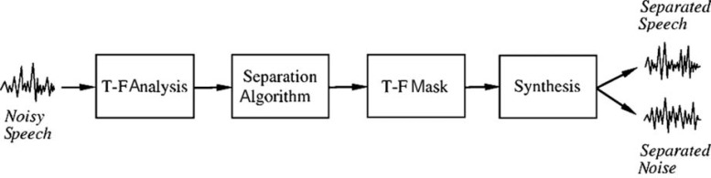
Proposed Method
DTLN-based AI model for adaptive and real-time noise suppression.
Dual-path LSTM networks process both short-term and long-term dependencies.
Preserves speech clarity while effectively suppressing background noise.
Optimized for deployment on mobile devices, embedded systems, and cloud-based platforms.
Handles both stationary and non-stationary noise efficiently.

Slide 13
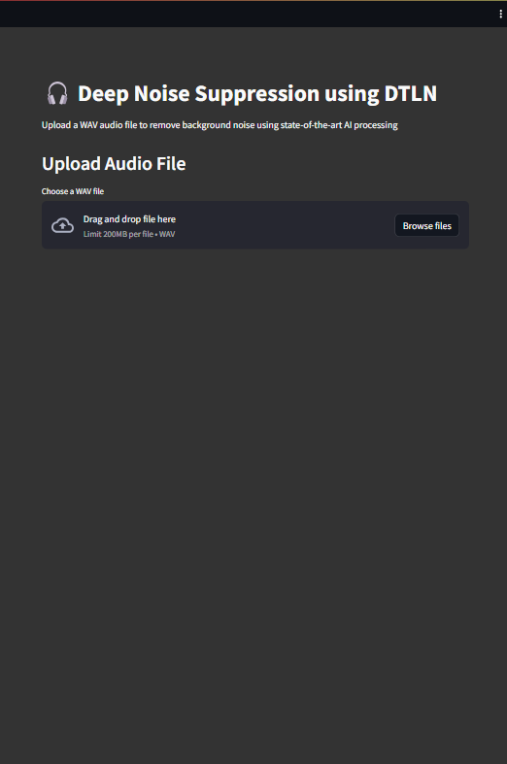
Presenting a Web Application

Slide 14
Module Wise Description
Signal Processing Module: Captures input audio, applies pre-processing, and removes unwanted noise.
DTLN Model Execution Module: Uses Dual Signal Transformation LSTM Network for real-time noise suppression.
User Interface Module: Built using Streamlit, allowing users to upload audio files or stream live input for noise reduction.
Audio Processing Module: Handles audio transformation, applies DTLN, and generates enhanced audio.
Storage & Logging Module: Stores processed audio logs, user preferences, and system configurations.

Slide 15
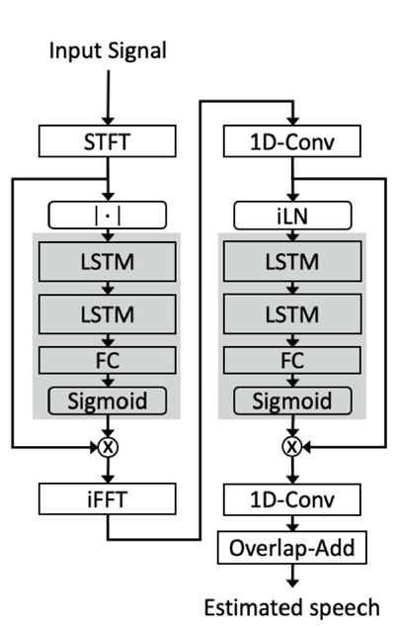
Model Architecture
Spectral Subtraction – Removes noise but introduces musical noise artifacts.
Wiener Filtering – Works for stationary noise but struggles with non-stationary noise.
Adaptive Filtering – Requires continuous tuning and high computational resources.
Limitations – High distortion, poor adaptability, and ineffective in real-time applications.

Slide 16
Methodologies
Data Pre-processing: Converts raw audio into spectrograms or waveforms for better noise reduction performance.
DTLN Network Processing: Uses a two-stage LSTM network for real-time noise suppression.
Model Optimization: Quantization and pruning improve efficiency for real-time applications.
Streamlit-based Frontend: Provides an interactive web-based UI for users to upload/record and process audio.
Performance Evaluation: Measures system efficiency using SNR (Signal-to-Noise Ratio) and PESQ (Perceptual Evaluation of Speech Quality).

Slide 17
Requirement Analysis
Hardware Requirements
Software Requirements
Processing Unit: High-performance CPU/GPU for real-time inference.
Microphone & Speakers: High-quality audio input and output devices.
Storage: Sufficient disk space for storing processed audio and logs.
Power Supply: Stable power source if deployed on embedded devices.
Programming Language: Python for backend processing and UI development.
Frameworks & Libraries: TensorFlow for DTLN, Streamlit for the web interface.
Audio Processing Libraries: Librosa, Soundfile for handling audio transformations.

Slide 18
Design & Implementation
Frontend Implementation: Streamlit UI allows users to upload and process audio files easily.
Backend Processing: Handles real-time DTLN model inference and audio enhancement.
Model Deployment: The optimized DTLN model is integrated into the backend for efficient execution.
Audio File Handling: Uses Python libraries (Librosa, Soundfile) to read, process, and export enhanced audio.
Integration Testing: Ensures smooth interaction between Streamlit UI and backend for real-time processing.

Slide 19
Consideration for Public Health, Safety, and Environment
Public Health:
Reduces background noise in real-time for better speech clarity.
Helps individuals with hearing impairments by enhancing speech signals.
Safety Considerations:
Ensures clear communication in critical environments like hospitals, aviation, and public transport.
Can be applied in security systems to enhance speech in noisy environments.
Environmental Impact:
Reduces noise pollution by suppressing unwanted background sounds.
Optimized model ensures energy efficiency when running on low-power devices.

Slide 20
IT Tools Usage and Justification
Streamlit: Enables a lightweight and interactive web-based UI for real-time audio processing.
TensorFlow/Keras: Provides deep learning capabilities for DTLN noise suppression.
Librosa & Soundfile: Efficient libraries for handling and processing audio data.
Python & NumPy: Core tools for implementing signal processing and deep learning models.
PostgreSQL: (If used) for storing user logs, processed audio, and system configurations.
Justification: These tools ensure efficiency, scalability, and real-time performance while maintaining ease of use and deployment.

Slide 21
Adopting Norms
IEEE Standards for Audio Processing: Ensures high-quality speech enhancement.
AI Ethics & Bias Consideration: The model is trained on diverse datasets to avoid speech distortions.
Software Development Best Practices:
Modular code for maintainability.
Documentation and version control (e.g., GitHub).
Energy-Efficient Computing: Optimized model reduces computational overhead.
User-Friendly Interface: Designed to be accessible for non-technical users.

Slide 22
Synthesis and Valid Conclusion of the Project
The DTLN-based noise cancellation system effectively removes background noise in real time.
Streamlit UI provides a simple and efficient way for users to interact with the model.
The solution is scalable and can be integrated into various applications, such as online meetings, hearing aids, and call centers.
The model has been optimized for low-latency processing, making it suitable for real-time deployment.
Future Enhancements:
Extending support for multiple audio formats.
Improving model accuracy for extreme noise conditions.
Deploying the system on mobile or embedded platforms.

Slide 23
Novelty of the Work
Real-time Processing: Unlike traditional noise reduction techniques, this system processes audio on the fly.
Deep Learning-based Approach: Uses DTLN instead of conventional filtering methods.
User-friendly Interface: Provides a web-based solution via Streamlit, eliminating complex software installations.
Cross-domain Application: Can be used in call centers, teleconferencing, hearing aids, and public announcement systems.
Optimized for Performance: The model is lightweight, making it suitable for real-time execution even on low-power devices.

Slide 24
Result & Discussion
The DTLN model significantly improves speech clarity by reducing background noise.
Achieved high SNR (Signal-to-Noise Ratio) and PESQ (Perceptual Evaluation of Speech Quality) scores.
Streamlit UI ensures easy interaction and real-time processing.
Minor challenges include handling extreme noise conditions and overlapping speech.

Slide 25
Conclusion & Future Work
The project successfully implements real-time noise cancellation using deep learning.
The system is scalable for various applications, including teleconferencing and hearing aids.
Future work includes mobile deployment, multi-speaker enhancement, and adaptive noise suppression.
Further model optimization is needed for low-power devices and embedded systems.

Slide 26
Reference
[1] I. Kavalerov, S. Wisdom, H. Erdogan, B. Patton, K. Wilson, J. Le Roux, and J. R. Hershey, “Universal sound separation,” in 2019 IEEE Workshop on Applications of Signal Processing to Au dio and Acoustics (WASPAA). IEEE, 2019, pp. 175–179.
[2] J. L. Ba, J. R. Kiros, and G. E. Hinton, “Layer normalization,” arXiv preprint arXiv:1607.06450, 2016. [22] Y. Luo and N. Mesgarani, “Conv-tasnet: Surpassing ideal time frequency magnitude masking for speech separation,” arXiv preprint arXiv:1809.07454, 2018.
[3] V. Panayotov, G. Chen, D. Povey, and S. Khudanpur, “Lib rispeech: an asr corpus based on public domain audio books,” in 2015 IEEE International Conference on Acoustics, Speech and Signal Processing (ICASSP). IEEE, 2015, pp. 5206–5210.
[4] J. F. Gemmeke, D.P.Ellis, D. Freedman, A. Jansen, W. Lawrence, R. C. Moore, M. Plakal, and M. Ritter, “Audio set: An ontology and human-labeled dataset for audio events,” in 2017 IEEE Inter national Conference on Acoustics, Speech and Signal Processing (ICASSP). IEEE, 2017, pp. 776–780.
[5] Z.-Q. Wang, J. L. Roux, D. Wang, and J. R. Hershey, “End-to-end speech separation with unfolded iterative phase reconstruction,” arXiv preprint arXiv:1804.10204, 2018.

Slide 27
Thank you!

